Slide 1
OLS Assumptions
SSI II
February 26, 2019

Slide 2
Previously…
OLS Regression
Estimating population parameters from the sample estimates
Uncertainty

Slide 3
Essential Questions
What assumptions do we need to make in order to make inferences using OLS regression?

Slide 4
Goal of Inference
To make claims about the population based on the sample
Doing this requires certain assumptions

Slide 5
Previous Assumptions
Random sample
Bivariate relationships (for bivariate regression)
Linear relationships

Slide 6
But…
If these assumptions are wrong, then our claims about the relationship in the population may be wrong

Slide 7
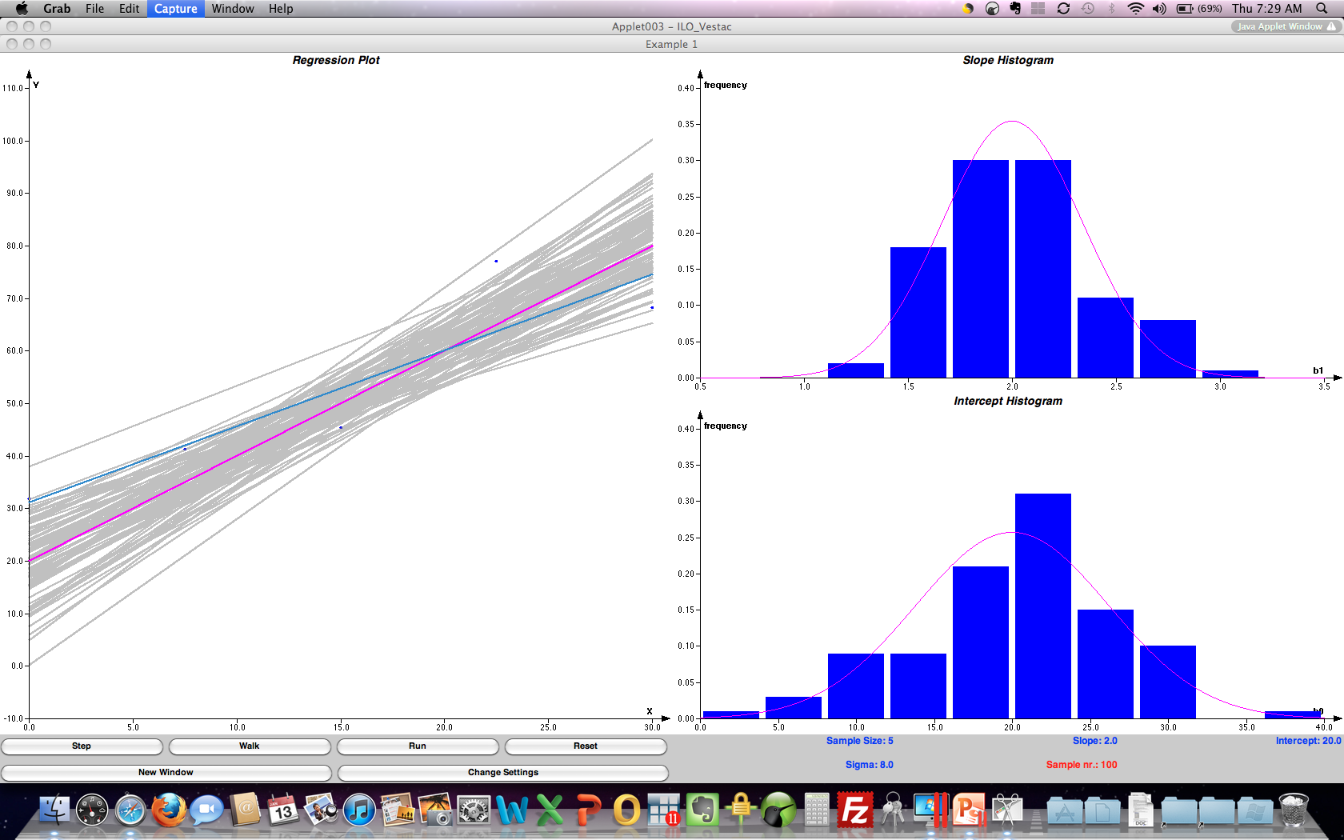
Sampling Distribution
Example of OLS-produced sampling distribution: N=5, β₀=20 β₁=2, σ=8, number of samples=100

Slide 8
Estimators should be…
Unbiased
E(β-hat)=β
On average, we want the value of the slope we estimate with our sample data to be the true population value; we neither underestimate nor overestimate the population value using the given estimator

Slide 9
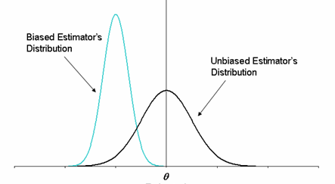
Unbiasedness

Slide 10
Estimators should be…
Efficient
Have smaller variances and standard errors
Allows us to be more confident that our estimates are as close as possible to the population parameter
Allows us to have more confidence in conclusions from hypothesis tests

Slide 11
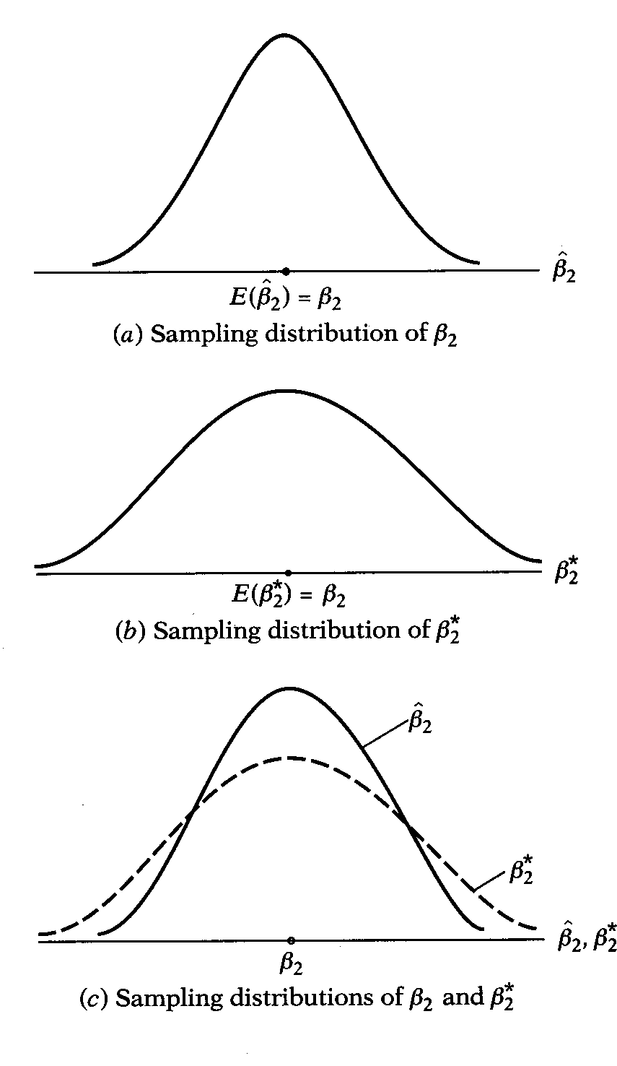
Efficiency

Slide 12
Estimators should be…
“Consistent”
They get closer and closer to the population parameter as the sample size (N) increases

Slide 13
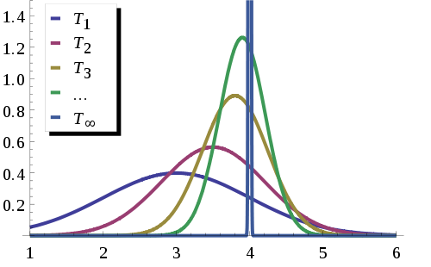
“Consistency”

Slide 14
OLS
If the following assumptions hold, then OLS is all of these things!

Slide 15
Assumption: Model is correctly specified
The variables that you included in the model are the correct ones – they are what really causes the dependent variable
This will be violated if:
You omit relevant variables
You include irrelevant variables
The relationship between X and Y is not linear
There is reciprocal causality between X and Y

Slide 16
Omitted Variable Bias
The omitted variable is in the error term
If the omitted variable is unrelated to X, OLS will be:
Consistent
Inefficient (the error is too big)
So it will be harder to find significance
If the omitted variable is related to X, OLS will be:
Biased – some of the true effect of the omitted variable will be attributed to X, making the effect seem stronger than it is
Inconsistent
Inefficient
This is one form of “endogeneity” (when X and the error term are correlated)

Slide 17
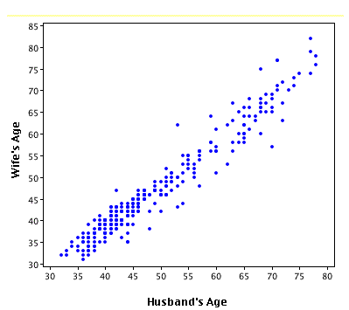
Linear Relationship

Slide 18
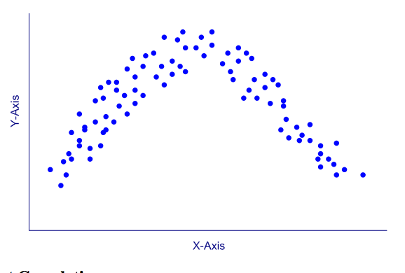
Non-linear Violates OLS Assumptions

Slide 19
Non-Linear Relationships
Quadratic “U-curve”
Quadratic “Inverted U-curve”
“Logarithmic”
Estimating a linear relationship will produce bias
But you can transform the variables to make this work
“polynomial” or “cubic”

Slide 20
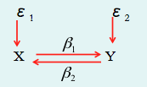
Reciprocal Causality
An estimate of the effect of X on Y will include some of the effect of Y on X
Leads to bias and inconsistency
This is another form of “endogeneity”

Slide 21
Assumption: No Measurement Error
Measurement error in Y
Adds another type of error to the equation, but OLS treats it all as u
So OLS overestimates u, leading to larger standard errors and a lower R-squared
Measurement error in X
Still another type of error, so same problem as above
But now X is related to that error, so “endogeneity”
OLS will be biased, inconsistent, and inefficient

Slide 22
Assumption: Variation in X
This one should be fairly obvious
There has to be variation in X with which to explain variation in Y

Slide 23
Assumption: No perfect multicollinearity among Xs
Only relevant in multivariate regression
If two variables are perfectly correlated, how does OLS know which one to attribute the effect to?
Multicollinearity above .7 or .8 may also become problematic

Slide 24
Error term assumptions
Normality: Errors are distributed normally with mean 0 and variance σ²
Includes that there is no bias
Independence: Each observation’s error does not depend on any of the other errors or on X (uncorrelated)
Homoskedasticity: Each observation has equal error variance
Notes:
\sigma^2 is ALSO AN UNKNOWN PARAMETER that we ESTIMATE
decompose assumptions about error term
No bias: Errors are mean zero =>– errors are completely “random” (not systematic)
Homoskedasticity: Equal error variance
Independence: Errors are independent, do not depend on each other (also known as no autocorrelation); e.g., if we are doing a regression involving states, the error term for PA is unrelated to the error term for OH

Slide 25
Endogeneity
When X and u are correlated
Occurs with:
Measurement error in X
Omitted variables that are correlated with X
May be a particular problem for panel or time series models, where there are unobserved factors affecting the same unit and multiple time points
Reciprocal causality between X and Y

Slide 26
Homoskedasticity
Equal error variance at all levels of X
OLS will be unbiased but inefficient
Weighted Least Squares or “robust” standard errors can produce less variance
Y
Y
Homoskedasticity
Heteroskedasticity

Slide 29
No Autocorrelation
Part of the independence of error terms
Residuals for one case should be unrelated to the residual for all other cases
Particularly problematic in time series or panel data
The current value of Y may depend on the previous level of Y
For example:
GDP at one point in time is dependent on GDP at the previous time
Weight in a weight loss study is dependent on previous weight

Slide 30
Autocorrelation
Will lead to inefficiency
May lead to bias
β
β
OLS b
X
X

Slide 31
Autocorrelation
Multiple possible solutions
Simplest is to include a lagged value of Y, may not be perfect
Can also include unit dummies or fixed effects
We will come back to this

Slide 32
“BLUE”
Best Linear Unbiased Estimator
OLS will be “BLUE” if:
The expected value of u is 0, or E(u_{i})=0
The expected covariance of X and u is 0, or E(X_{i}u_{i})=0
No autocorrelation

Slide 33
Hypothesis Testing
Adding the assumption that residuals are normally distributed allows us to:
Assume the shape of the sampling distribution
Make inferences about how far our sample values are from the population value

Slide 34
Assumption of Normal Residuals
10
8
6
4
2
Y
1
2
3
4
5
6
X

Slide 35
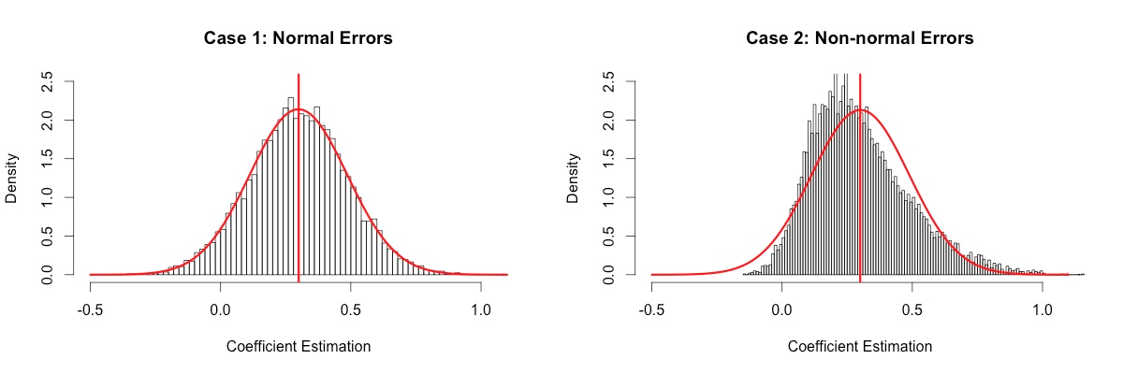
Normality of Errors

Slide 36
Implications of error term assumptions
Allows us to derive the sampling distribution of the OLS estimates
OLS estimate of β is “unbiased”
Notes:
Estimate of uncertainty is “unbiased” (the average estimate will equal the true variance)

Slide 37
Implications of error term assumptions
Allows us to estimate the uncertainty of our sample regression estimates
Estimate of error variance
If the assumptions about the error term hold, then the estimate of the error variance is “unbiased” as well
Notes:
Estimate of uncertainty is “unbiased” (the average estimate will equal the true variance)
ALSO NOTE: we can interpret the estimate of the error variance as REMAINING VARIANCE IN Y THAT IS UNEXPLAINED BY X

Slide 38
Implications of error term assumptions
Normality of error term implies normality of OLS estimates
Allows us to derive the distribution of test statistics involving the OLS estimates

Slide 39
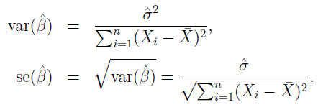
Variance and Standard Errors for β
Once we have estimated σ², the variance and standard errors for the slope parameter estimate β are then estimated from the following formulae:
In the numerator, we find σ values. So the larger these are, the larger the variance and standard error of β

Slide 40
A closer look…
Numerator – standard error of estimate
Larger residuals will lead to larger standard errors
Smaller error sums of squares (and larger R-squared) will lead to smaller standard errors
A Larger N will lead to smaller standard errors

Slide 41
Variance and Standard Errors for β
In the denominator, we have a measure of the variation of the X_{i} values around their mean
The greater this variation, the smaller will be the variance and standard error of β
Simply, more variation in X means we can estimate the relationship more precisely

Slide 42

Sampling Distribution of β
34.0 %
34.0 %
$$β$$

Slide 43
Hypothesis testing
Null hypothesis that slope is β*
β* is almost always 0
H₀: β=β* H_{A}: β≠β* (two-tailed)
H_{A}: β<β* or H_{A}: β>β* (one-tailed)
t-test
Follows t distribution with n-2 degrees of freedom

Slide 44

Confidence Intervals
Same basic steps
The formulae are:
t is the value for t from the t-table
Depends on N, but it will be approximately 2 for 95%
If your confidence interval crosses 0, you don’t have a significant relationship*
*unless you are testing something other than whether X affects Y

Slide 45
Other Requirements
There must be more observations than variables (n > k)
Ideally you should have at least ten observations per variable

Slide 46
Essential Questions
What assumptions do we need to make in order to make inferences using OLS regression?

Slide 47
Next Time…
Extensions to OLS
Using categorical variables
Interaction terms

